Slide 1
Identifying Hardware and Software Factors Affecting the Touchscreen Responsiveness of Android Smartphones
CORONEL | DELA CRUZ | JIMENEZ | LLANTOS

Slide 2
Project Context
The CHALLENGES
Inaccuracies
The Opportunity
Future Smartphones
Purpose and Description
Identify
Effects
Notes:
The Challenges (shen)
Android smartphone users still experiences touchscreen inaccuracy despite the manufacturers’ continuous efforts to enhance their products. According to the technology strategist of Synaptics, Andrew Hsu, touch-based mobile phones involve a lot of development work and quite a bit of engineering expertise to give consumers the excellent quality.
The Opportunity (shen)
This research can help to improve future android smartphones as this research can inform android smartphone manufacturers on areas to improve on their devices.
Purpose and Description (thom)
The purpose of this research is to identify the different hardware and software factors affecting the problems in android smartphone’s touchscreen responsiveness and accurateness. Also, this research will state how it affects the responsiveness and accurateness of android smartphone’s touchscreens.

Slide 3
Objectives
Integrate
Support
Hardware
Software
Analyze
Hardware
Software
Notes:
Develop (Thom) – Data Gathering Tool utilizing simple gestures. Gathering ((x and y coordinates, time, touch size, and touch amplitude))
* amplitude: the pressure axis is assumed to measure the signal amplitude, which is related to the size of the contact and the pressure applied.
Identify (Jobie)
Analyze (Marcla) –
To analyze the hardware and software factors affecting Android touchscreen responsiveness by comparing the different result sets with varying factors (will be stated later), we will be determining the effects it can do the the touchscreen responsiveness.
SOFTWARE FACTORS:
- User Interface
- Operating System
Hardware Factors:
- GPU
- RAM
- Noise (Electronics)
- Type of Touchscreen

Slide 4
Scope & limitations
Factors
Software
hardware
Operating system
OS Version
Notes:
HUMAN FACTORS (Marcla):
- Posture, Finger Size, Melioration, Eye Behavior, Finger Movements
SOFTWARE FACTORS (Jobie):
- User Interface
- Operating System
Hardware Factors (Thom):
- GPU
- RAM
- Noise (Electronics)
- Type of Touchscreen
Operating System (Shen) – Android Mobile Phones
OS Version (Shen) – Honeycomb or later

Slide 5


Technical Background
FIREBASE
JAVA
Notes:
TUIO – a transmission protocol for the touch events, to be sent for interpretation.
Firebase – Googles Mobile Platform, with key features such as a database, to store the data that we need (time, x & y coordinates, touch amplitude, touch size)
Java – language used in Android Studio (where we are developing our application)

Slide 6
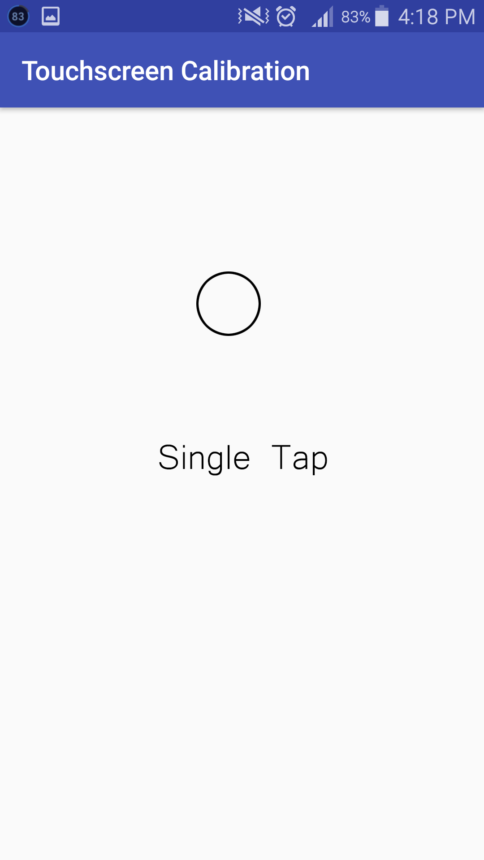
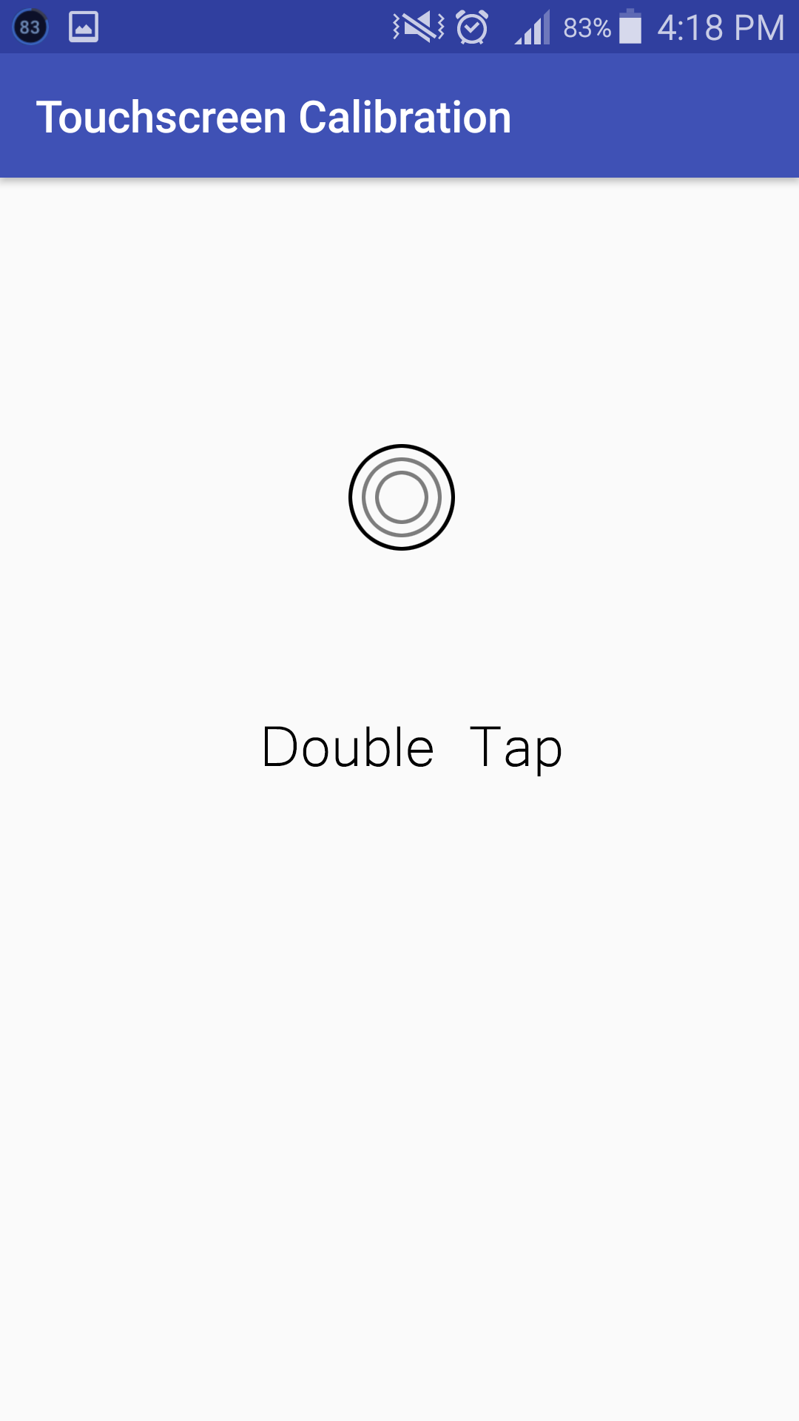
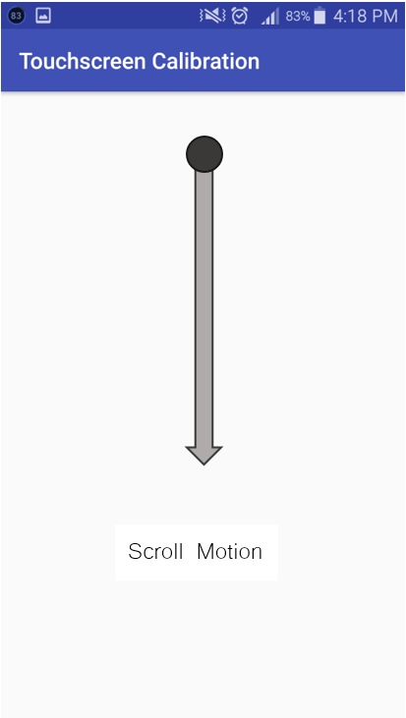
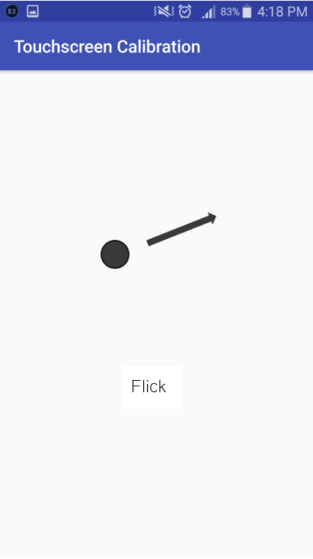
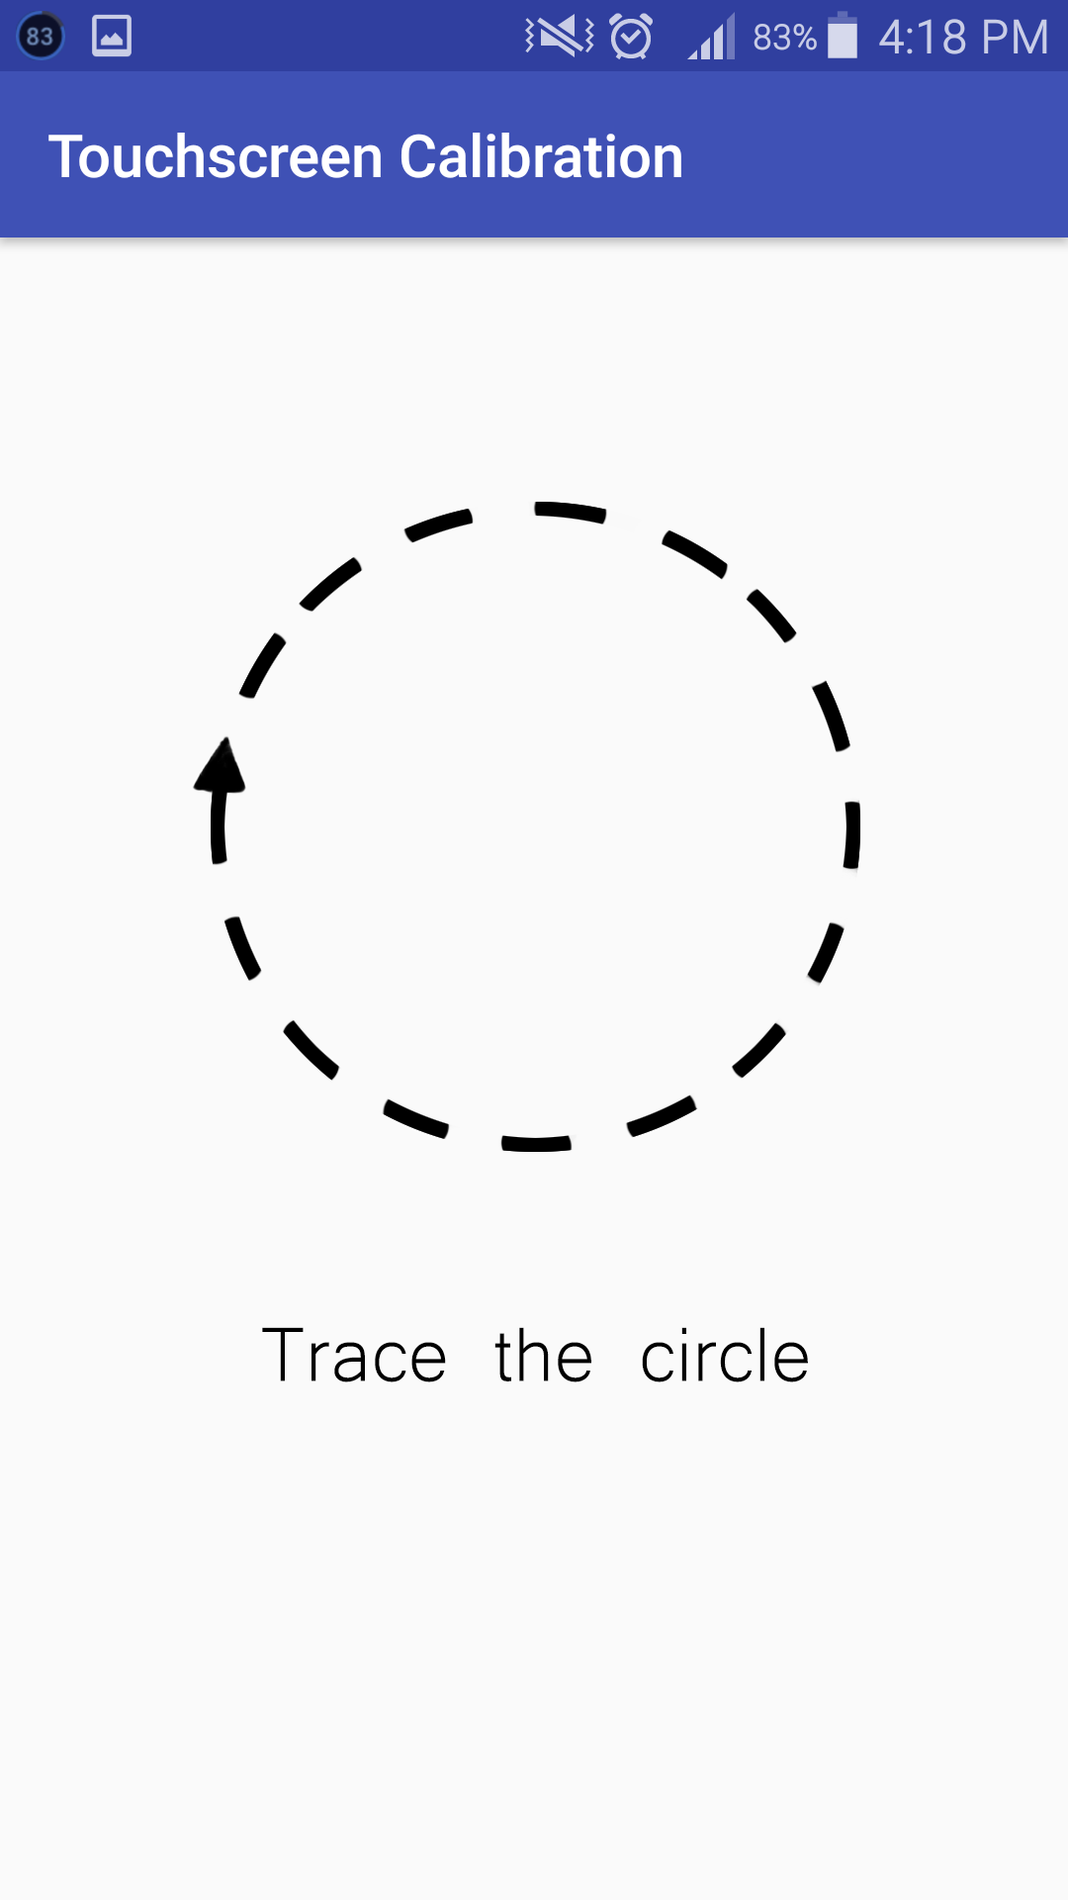
Plans for the Prototype
Notes:
FLIP – Time between press and detachment is less than 351ms & slide of the finger is bigger than 100 pixels vertically (Cichoń, Sobecki, & Szymański, 2013).
SCROLL – Finger moved at least 50 pixels in either direction (Cichoń, Sobecki, & Szymański, 2013).
DOUBLE TAPPING– first finger was pressed in less than 501ms & slide of the finger is not more than 50 pixels (Cichoń, Sobecki, & Szymański, 2013).
TAP – finger touches the screen for less than 1 second, and did not move for more than 50 pixels (Cichoń, Sobecki, & Szymański, 2013).
PRESS – finger touches the screen for more than 1 second, and did not move for more than 50 pixels (Cichoń, Sobecki, & Szymański, 2013).

Slide 7

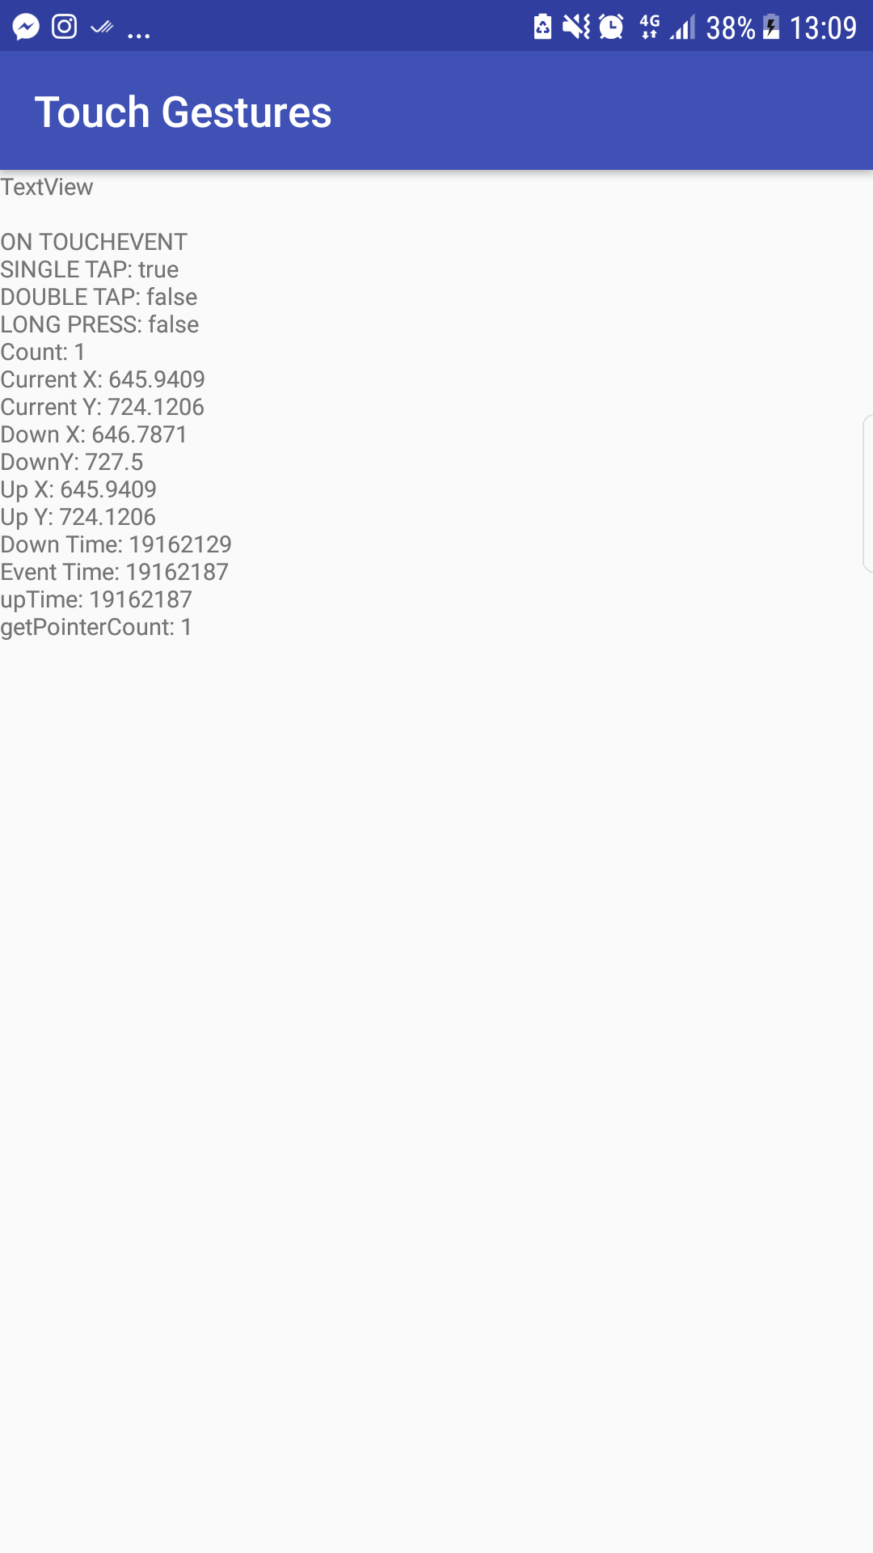
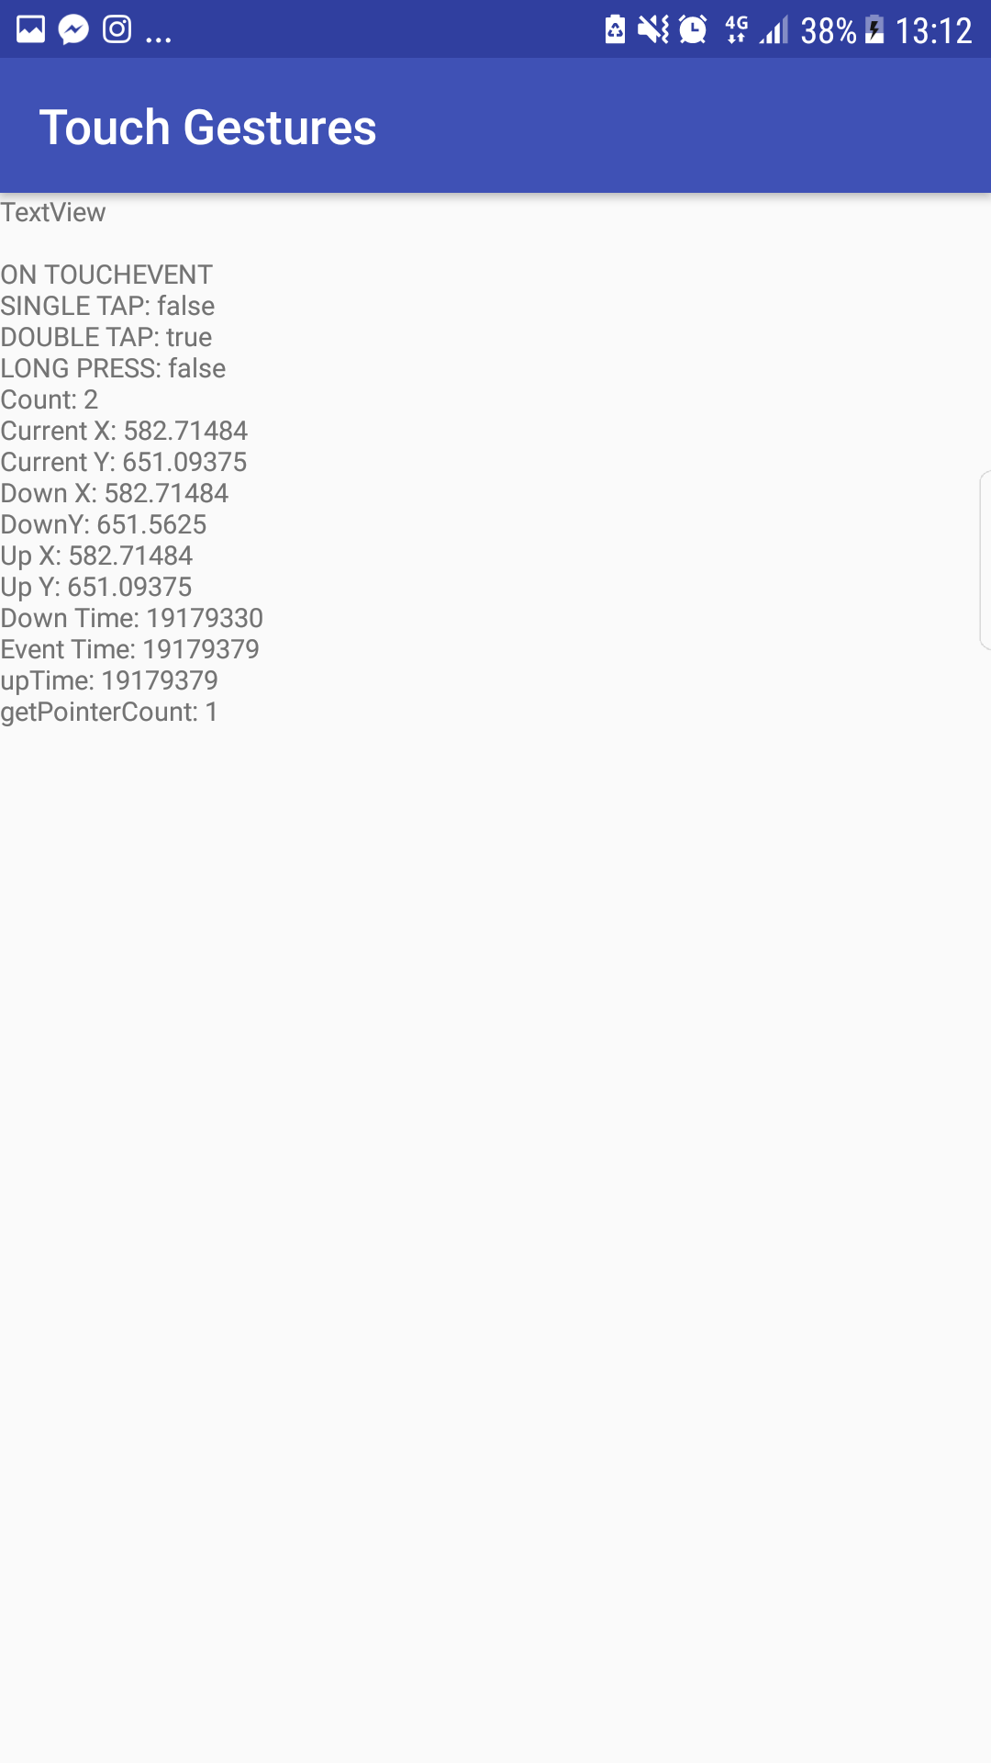
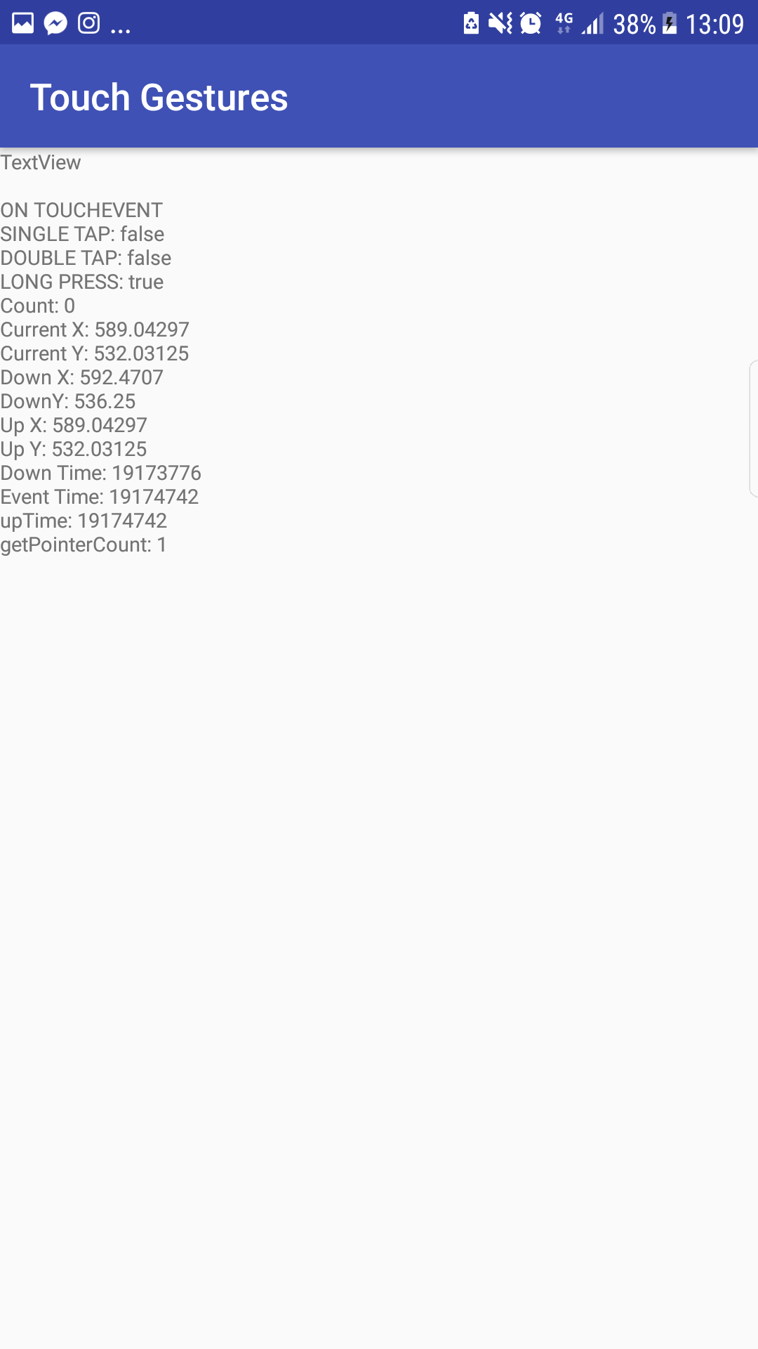
Current Prototype
Front-end
Gesture recognition
Single tap
DOUBLE TAP
LONG PRESS
Notes:
FLIP – Time between press and detachment is less than 351ms & slide of the finger is bigger than 100 pixels vertically (Cichoń, Sobecki, & Szymański, 2013).
SCROLL – Finger moved at least 50 pixels in either direction (Cichoń, Sobecki, & Szymański, 2013).
DOUBLE TAPPING– first finger was pressed in less than 501ms & slide of the finger is not more than 50 pixels (Cichoń, Sobecki, & Szymański, 2013).
TAP – finger touches the screen for less than 1 second, and did not move for more than 50 pixels (Cichoń, Sobecki, & Szymański, 2013).
PRESS – finger touches the screen for more than 1 second, and did not move for more than 50 pixels (Cichoń, Sobecki, & Szymański, 2013).

Slide 8
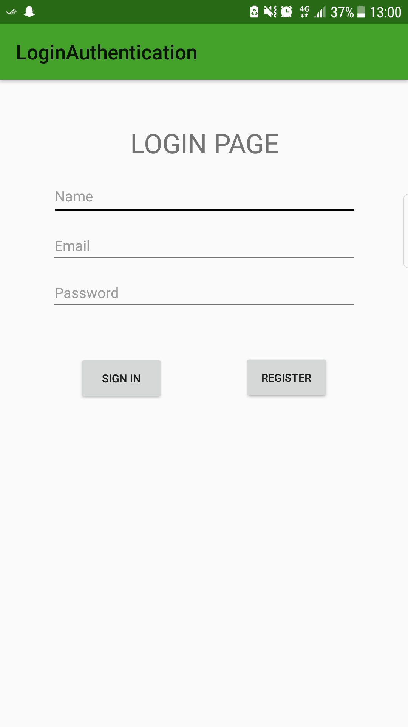
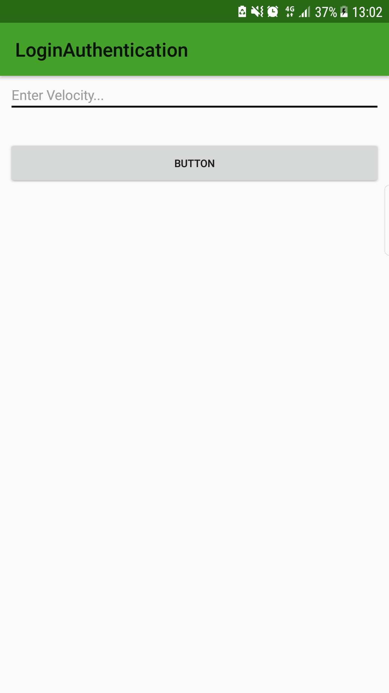
Current Prototype
Back-end
Front-end
FIREBASE IMPLEMENTATION
Leads to
Notes:
FLIP – Time between press and detachment is less than 351ms & slide of the finger is bigger than 100 pixels vertically (Cichoń, Sobecki, & Szymański, 2013).
SCROLL – Finger moved at least 50 pixels in either direction (Cichoń, Sobecki, & Szymański, 2013).
DOUBLE TAPPING– first finger was pressed in less than 501ms & slide of the finger is not more than 50 pixels (Cichoń, Sobecki, & Szymański, 2013).
TAP – finger touches the screen for less than 1 second, and did not move for more than 50 pixels (Cichoń, Sobecki, & Szymański, 2013).
PRESS – finger touches the screen for more than 1 second, and did not move for more than 50 pixels (Cichoń, Sobecki, & Szymański, 2013).

Slide 9
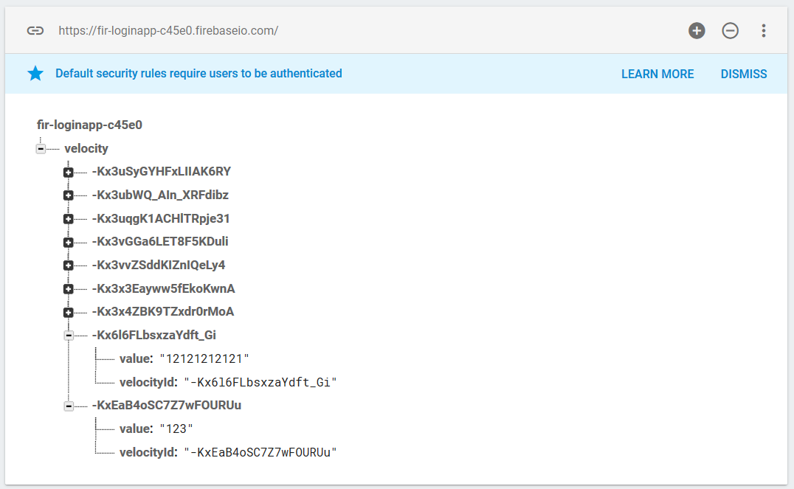
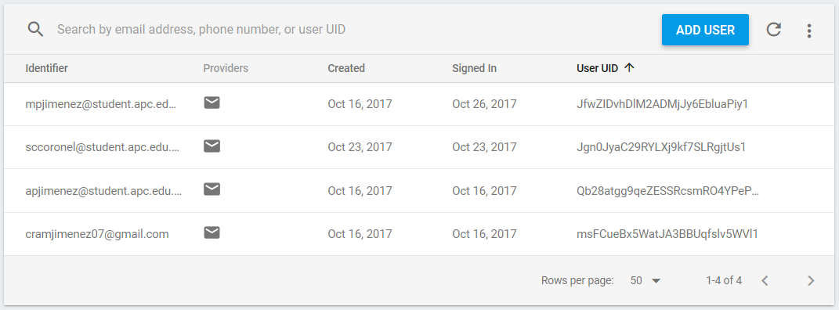
Current Prototype
Front-end
Back-end
Real time database
Authentication
Front-end
Notes:
FLIP – Time between press and detachment is less than 351ms & slide of the finger is bigger than 100 pixels vertically (Cichoń, Sobecki, & Szymański, 2013).
SCROLL – Finger moved at least 50 pixels in either direction (Cichoń, Sobecki, & Szymański, 2013).
DOUBLE TAPPING– first finger was pressed in less than 501ms & slide of the finger is not more than 50 pixels (Cichoń, Sobecki, & Szymański, 2013).
TAP – finger touches the screen for less than 1 second, and did not move for more than 50 pixels (Cichoń, Sobecki, & Szymański, 2013).
PRESS – finger touches the screen for more than 1 second, and did not move for more than 50 pixels (Cichoń, Sobecki, & Szymański, 2013).

Slide 10
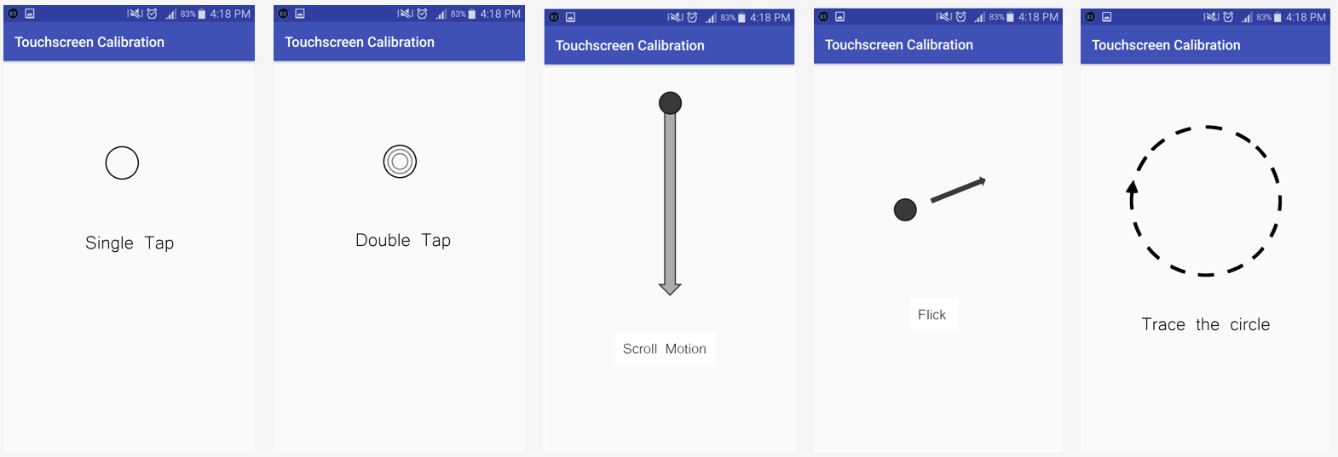
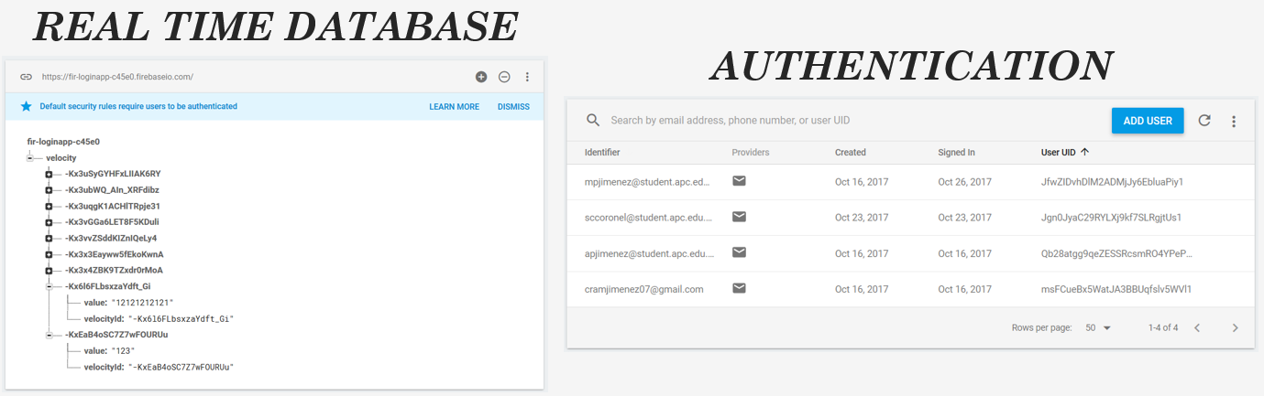
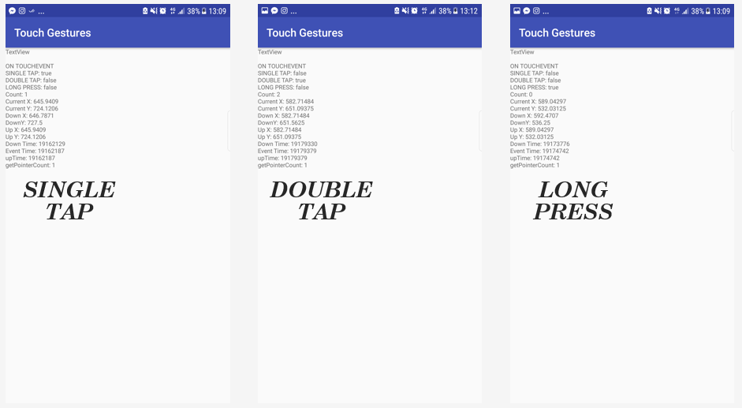
Identifying Hardware and Software Factors Affecting the Touchscreen Responsiveness of Android Smartphones
Front-end
Back-end
LOL, SCRAM
SCRUM?
Front-end
Notes:
Introduction – Marcla
We have 2 Major Accomplishments – Front End and Back End (insert kwento here)
ACCOMPLISHMENTS → Insert the topic kwento here (Shen)
Front End – show the planned front end
Back End – Real-time database & Authentication
CHALLENGES → that we face today now are: Front End (thom), Back End (jobie) → NoSQL
BEST PRACTICES → separate the responsibilities (most groups use SCRUM, but our group use SCRAM)

